Slide 1
Primary and secondary sclerosing cholangitis (including post-COVID presentations) and the recent new histological staging system
Irene Esposito
Institute of Pathology – University Hospital of Dusseldorf - Germany

Slide 2
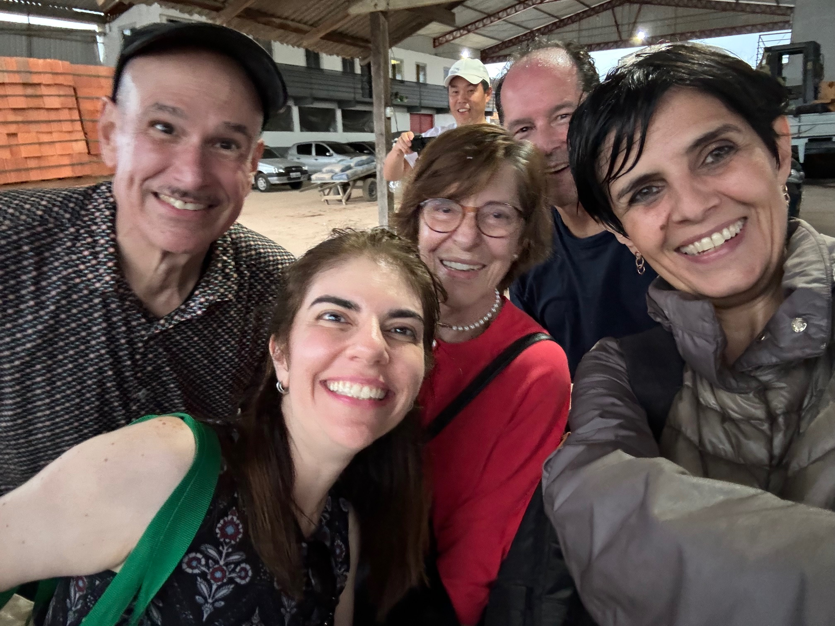

Slide 3
Disclosure of Relevant Financial Relationships
Dr. Esposito declares he/she has no
conflict(s) of interest to disclose
RDC Nº 96/08 da ANVISA

Slide 4
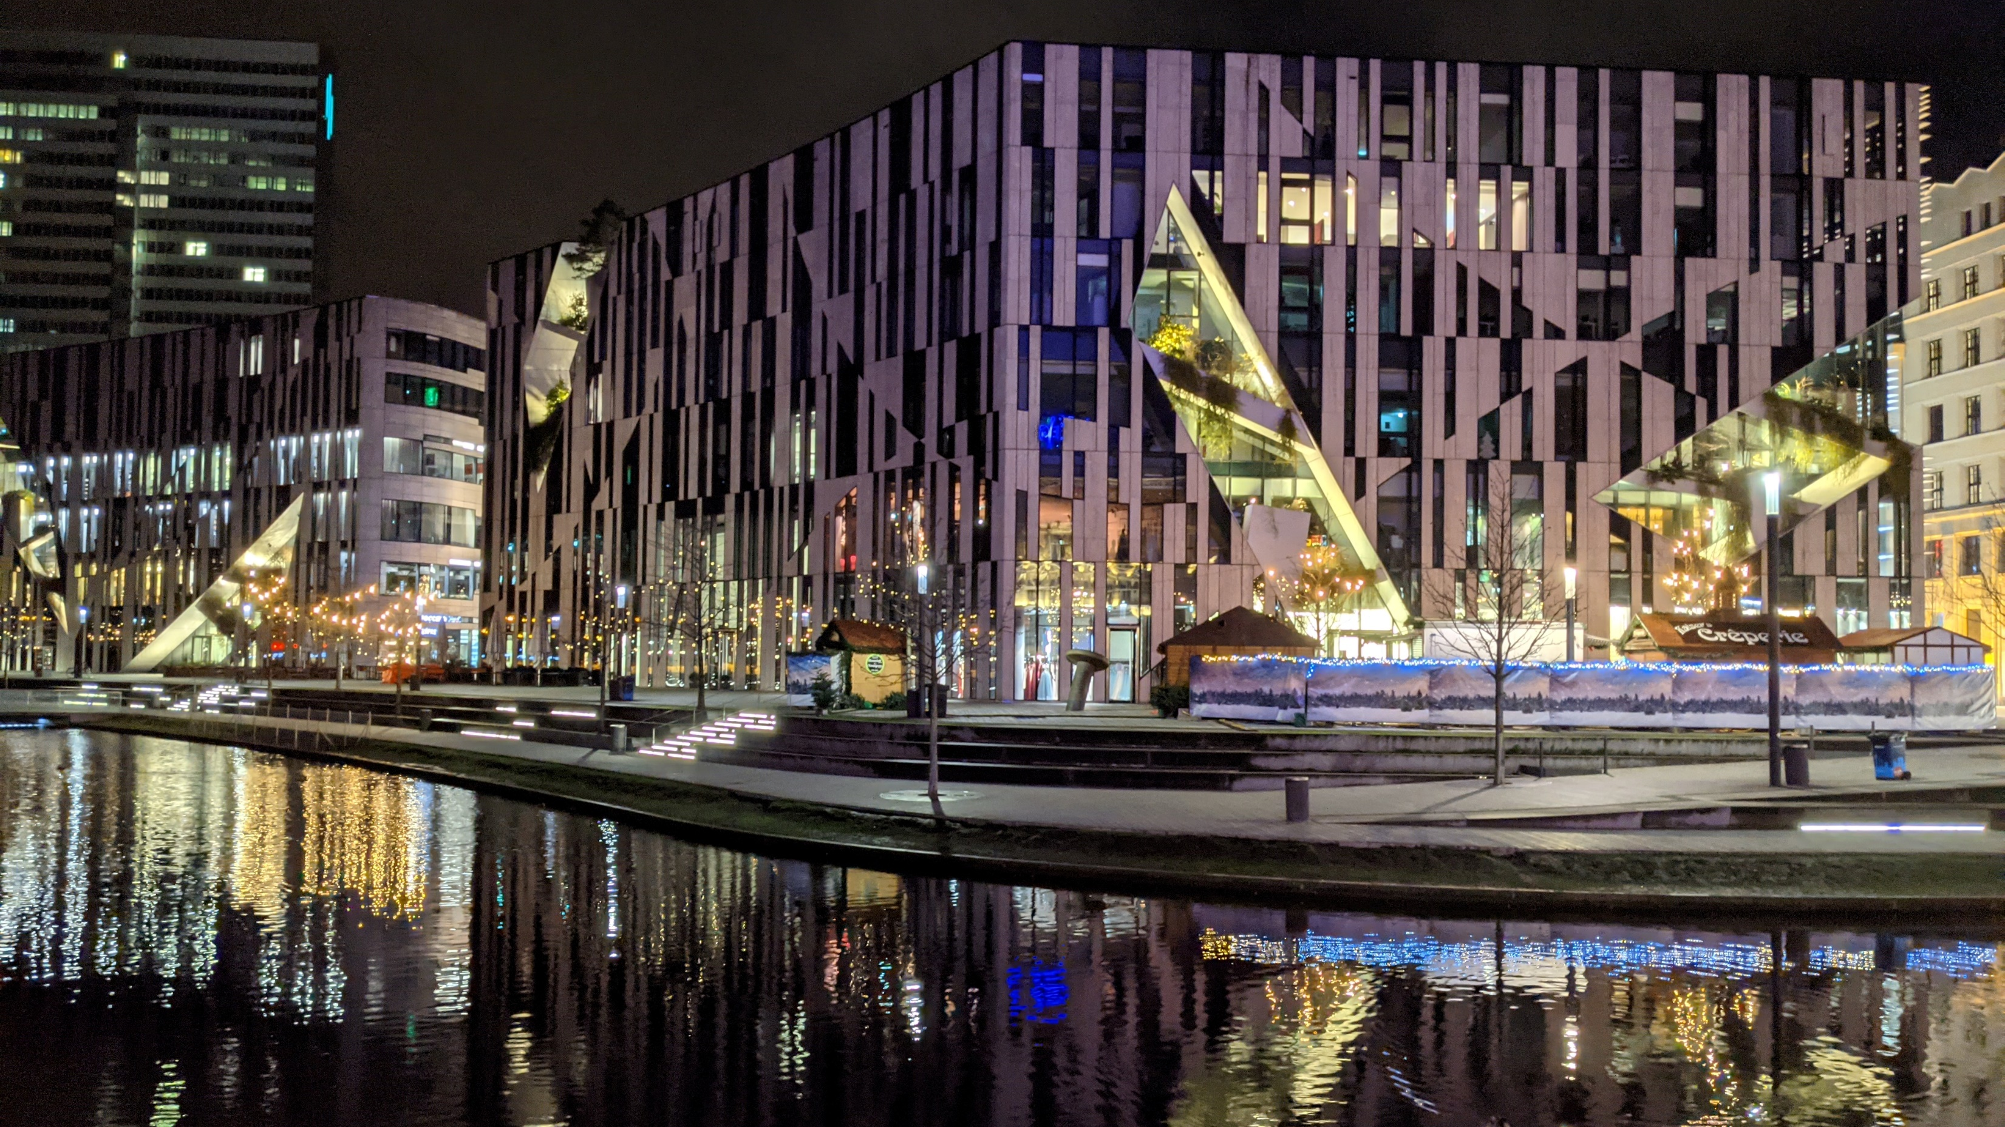
Kö-Bogen

Slide 5
Agenda
Classification of immune-related cholangiopathies
PSC – etiology, pathogenesis, clinical features & morphology
PSC – Staging
SSC with focus on ICU-SSC
Covid-related SSC

Slide 6

Definition & Classification
Immune-mediated cholangiopathies: chronic cholestatic disorders driven by auto- and allo-immunity
Entities:
Primary sclerosing cholangitis
Primary biliary cholangitis
IgG4-related sclerosing cholangitis
Graft-versus-host disease
Hepatic allograft rejection
Common feature: accumulation of T-cells at the site of bile-duct damage/destruction
Sarcognato et al, Pathologica 2021

Slide 7
PSC: Clinical aspects
Rare disease, incidence 1,3 /100,000 people/year; increasing
M>F (75% <50 years), no smokers
Association with IBD (70%; UC>>CD) and gallbladder diseases (stones, polyp, cancer)
Laboratory: Chronic cholestasis (ALP 2-3x), slight AST/ALT increase, bilirubin only in late stages
Autoantibodies: ANA, anti-cardiolipin, anti-thyroperoxidase, RF, pANCAs
Typical imaging (ERCP, MRCP) with bile duct strictures
Risk of cholangiocarcinoma (annual risk 2%; 30-year cumulative incidence 20%)

Slide 8
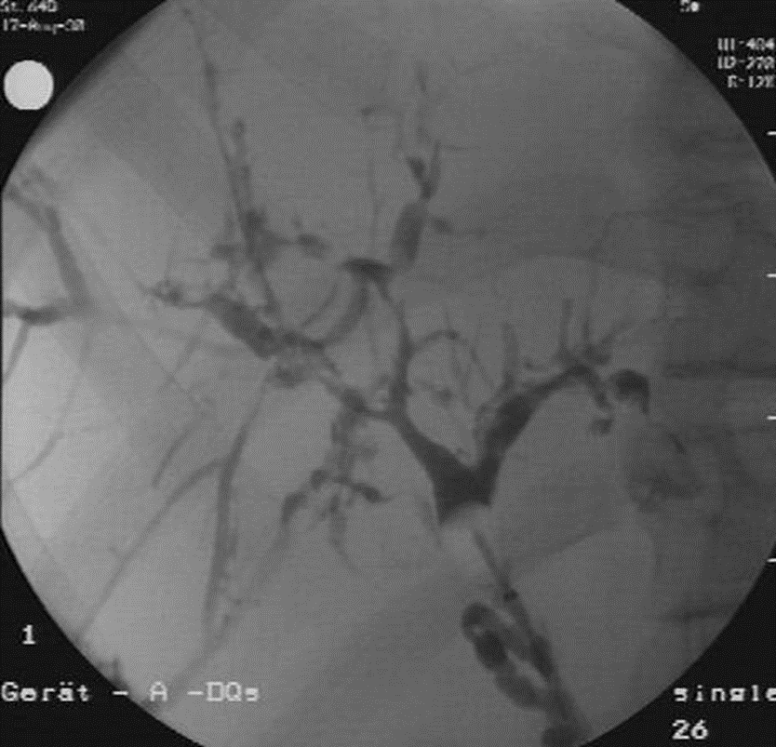

ERCP bei PSC

Slide 9
MRCP bei PSC
Berstad et al., Clin Gastro Hepatol 2006

Slide 10

PSC: Pathogenesis
Genetic (e.g. HLA) and environmental factors (not identified)
Microbiome
Gut lymphocyte homing hypothesis: intestinal T-cells are recruited to the liver due to the expression of specific adhesion molecules

Slide 11
PSC: Pathology – General aspects
PSC is a disease of the extra- and intrahepatic bile ducts of all sizes
Liver biopsy can be completely normal or just show secondary changes due to
large duct obstruction
The changes (including the pattern of cirrhosis) are unevenly distributed
Small-duct PSC: rare (max. 5% of the pat.) variant, no cholangiographic changes,
better prognosis, but it may evolve into large-duct PSC

Slide 12
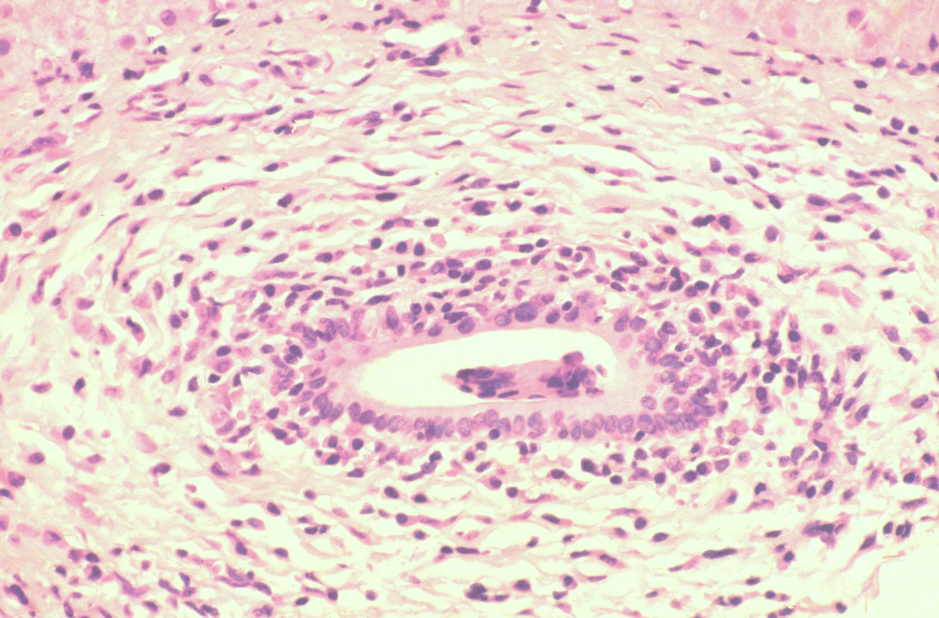
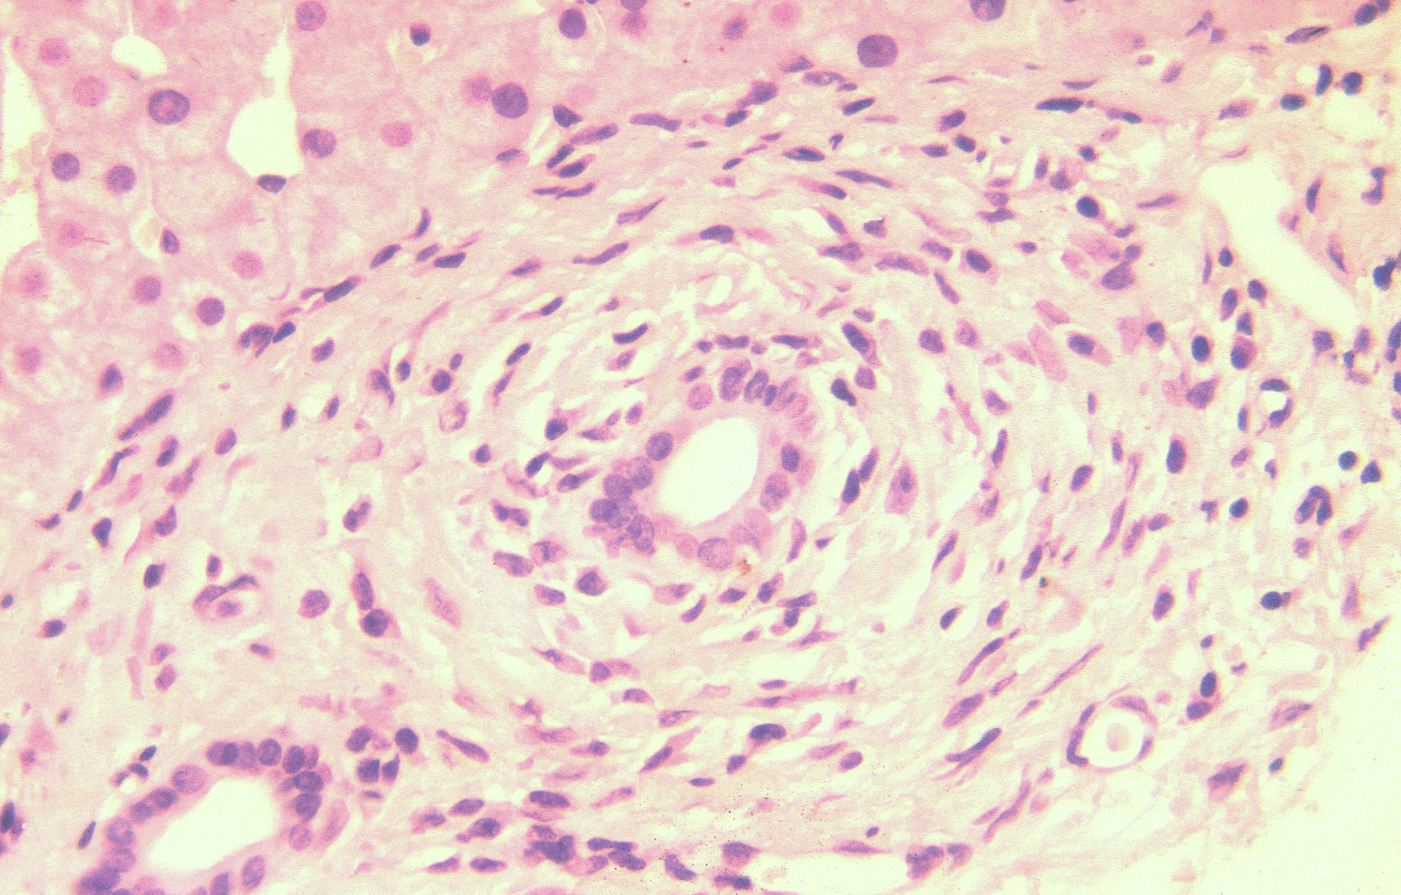
PSC: Pathology
Moderate periductal inflammation, oedema and obliterative concentric periductal fibrosis („onion skin“ fibrosis)

Slide 13
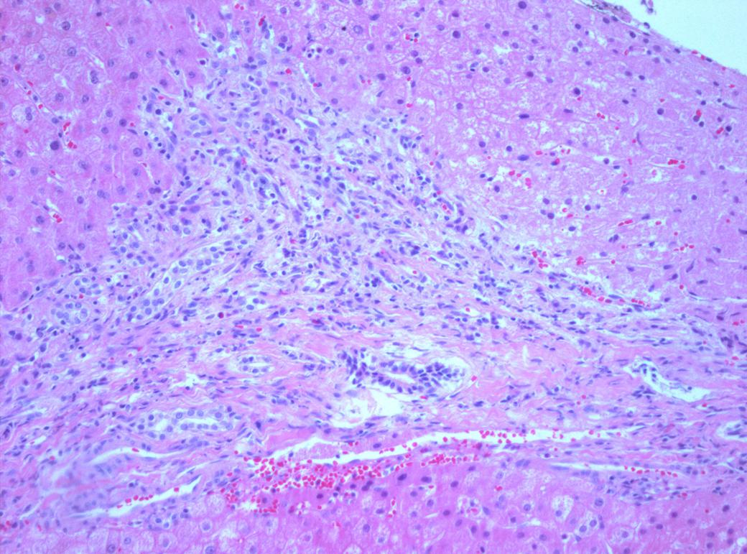
PSC: Pathology
Triangular configuration of portal tracts with
ductular reaction and mild inflammation/fibrosis
Irregular thickening of the basal membrane (PAS)

Slide 14
PSC: Pathology
In later stages: fibrous scarring (bile duct scars) with reduction in the number of interlobular bile ducts

Slide 15
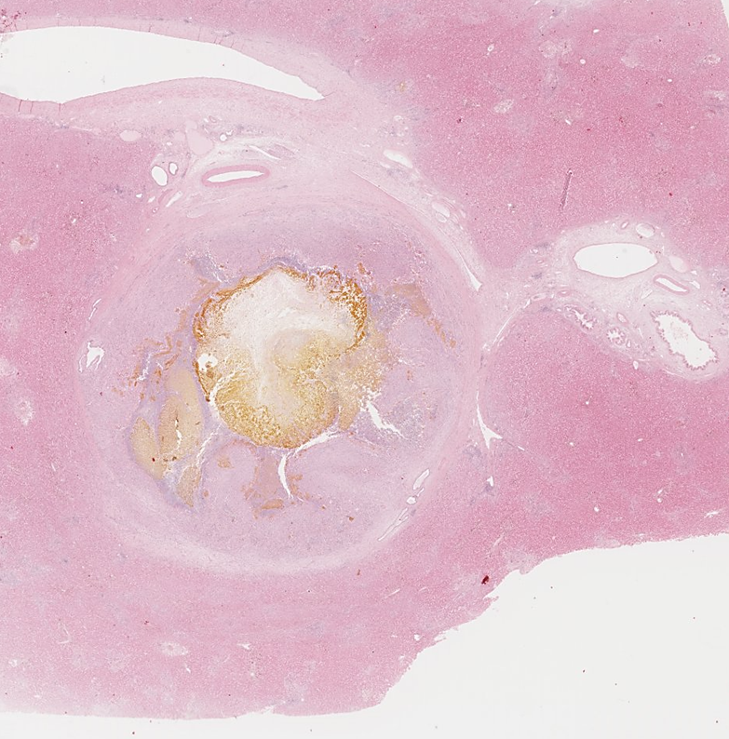
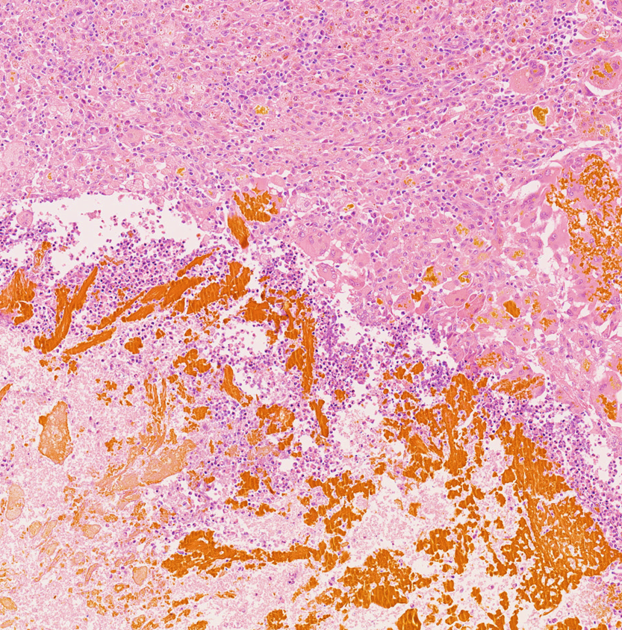

Slide 16
Staging of PSC
According to Nakanuma:
According to Ludwig & Scheuer:
I: Portal changes
II: Portal expansion, interface activity
III: Porto-portal septa
IV: Cirrhosis
Harada, J Clin Gastroenterol 2013; de Vries, Hepatology 2017

Slide 17
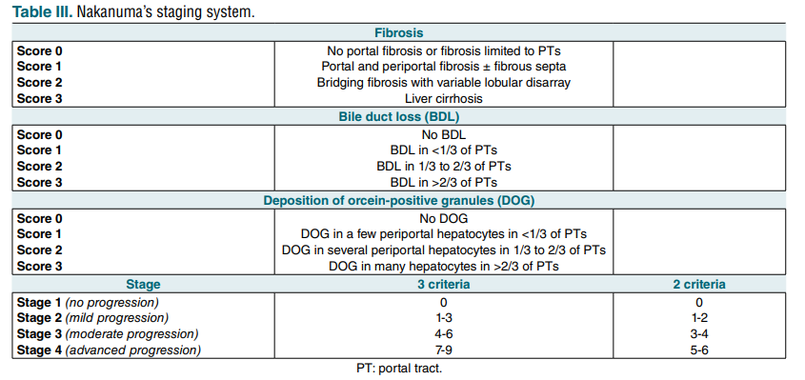
Nakanuma staging

Slide 18
Comparison of different staging systems
Ludwig – Ishak - Nakanuma
Three endpoints:
Composite PSC-related death and Ltx: Nakanuma (HR, 2.14 p= 0.008)
Liver transplantation: all three systems
Liver-related events: all three systems
The Nakanuma sytstem showed the strongest predictive value and a good interobserver agreement (0.56; range: 0.41-0.75)
De Vries et al, Hepatology 2017

Slide 19
Malignancy in PSC
604 PSC patients
Follow up: 5.7 years (0-28 years)
79% mit IBD
Mortality: 28 % (171 / 604)
Primary cause of death: (n=171)
Malignancy 44% (75/171) !
Liver disease 37 % (63 /171)
Others 19 % (33 /171)
161x-increased risk for hepatobiliary malignancy
Bergquist et al. J Hepatol 2002

Slide 20
Role of liver Bx in PSC
Atypical presentations (SD-PSC, overlap)
Prediction of prognosis prior to Ltx
Diagnosis/differential diagnosis of cholangiocarcinoma (in case of dominant stenosis)
But not for diagnosis!

Slide 21
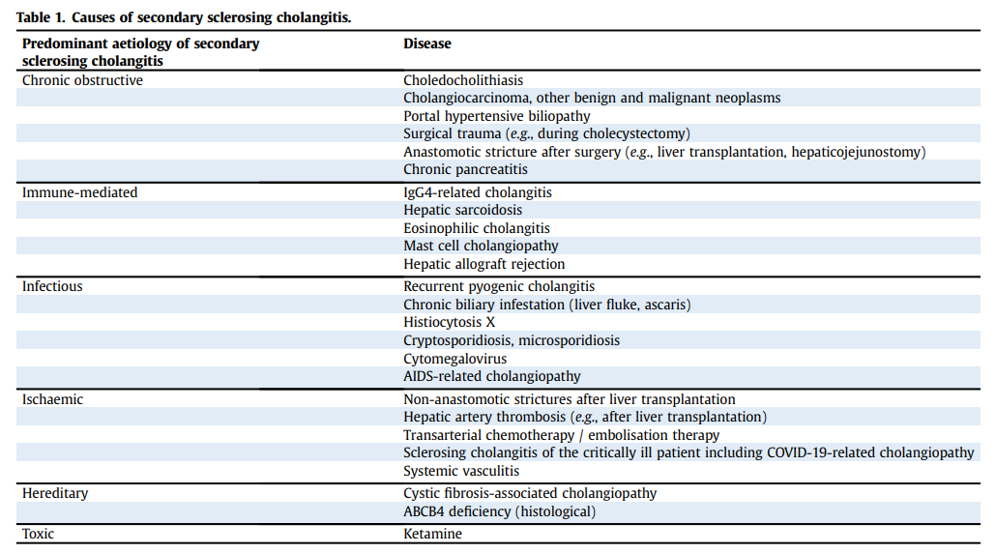
Secondary sclerosing cholangitis
EASL clinical practice guideline, J Hepatol 2022

Slide 22
ICU-SSC
Patients after (or during) long ICU stay (median: 33 days) due to septic schock
Mechanical ventilation, TPN, Catecholamin- and antibiotic therapy
Despite successful treatment of the sepsis→ Cholestasis
(Bili 1,5-15x ↑; ALP 3-19x ↑; GGT 5-22x ↑)
Disease course: acute liver failure or biliary cirrhosis
Median survival without LTx: 1,1 y
Scheppach et al., Crit Care Med 2001
Jaeger et al, Endoscopy 2006
Gelbmann et al, Am J Gastroenterol 2007
Kulaksiz et al., Endoscopy 2008
Esposito et al., Virchows Arch 2008
Kirchner et al., Scand J Gastroenterol 2011

Slide 23
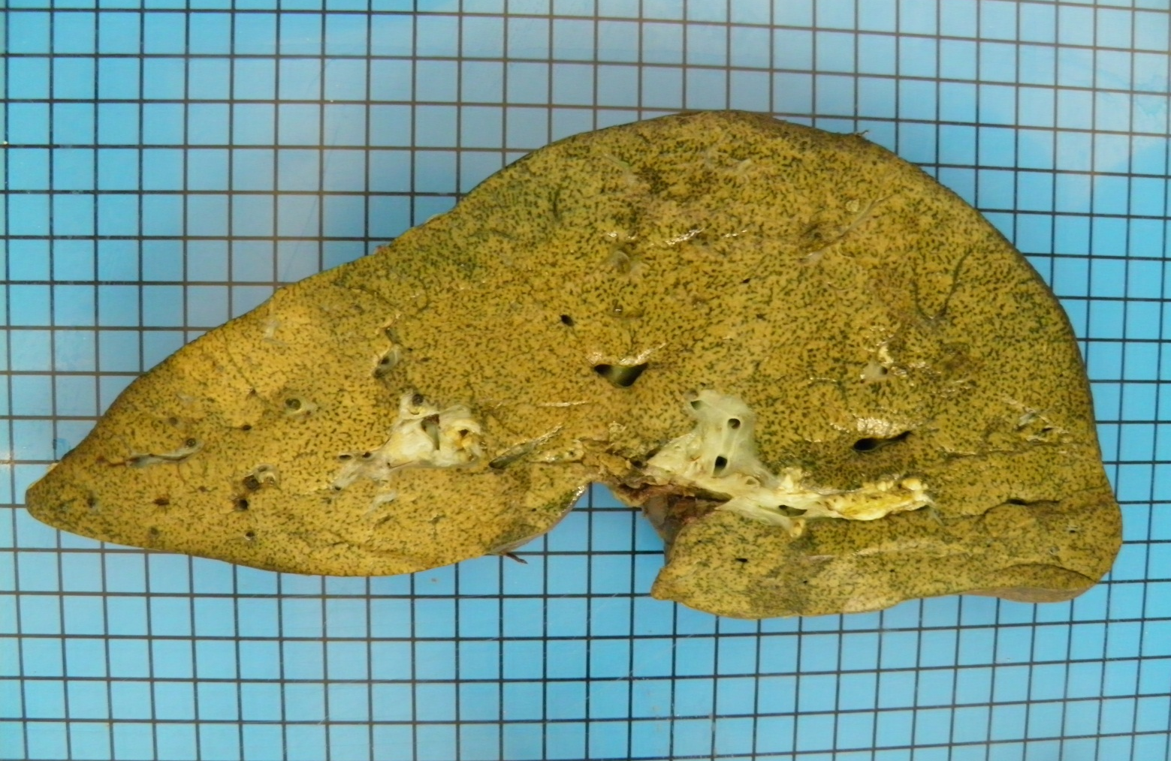
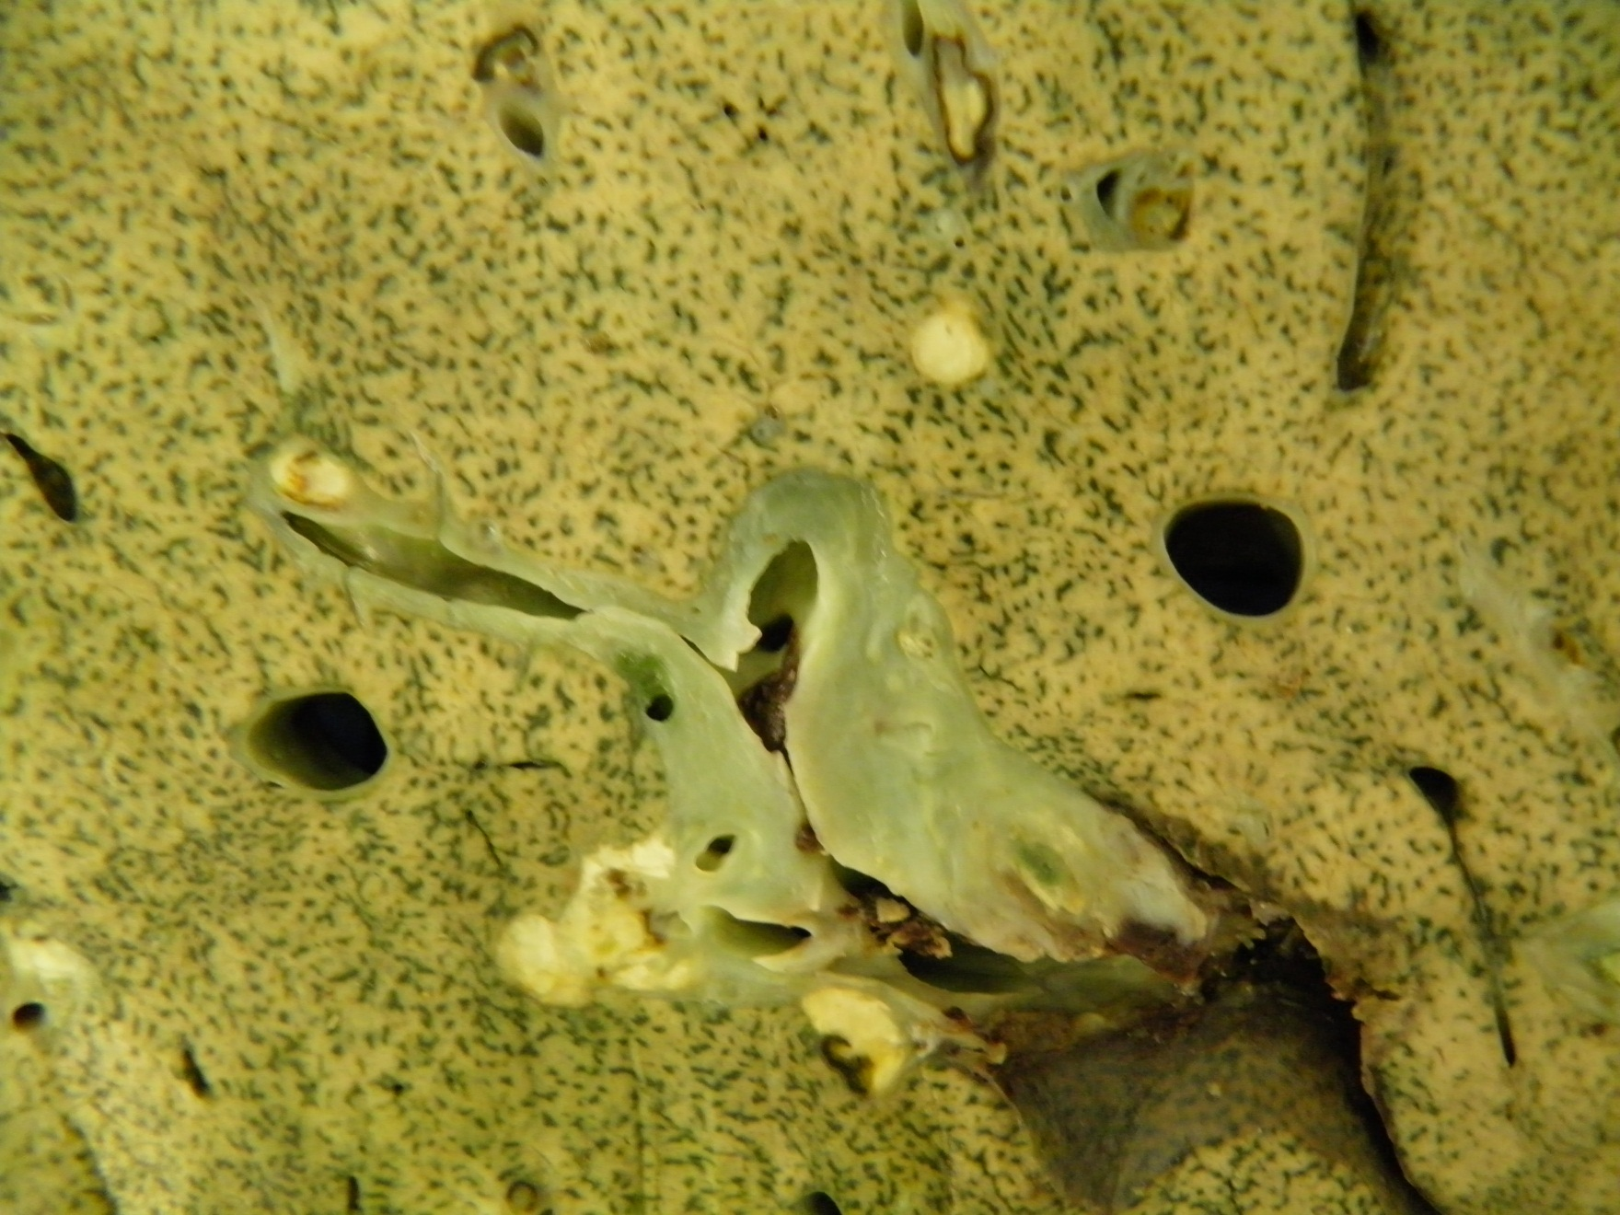
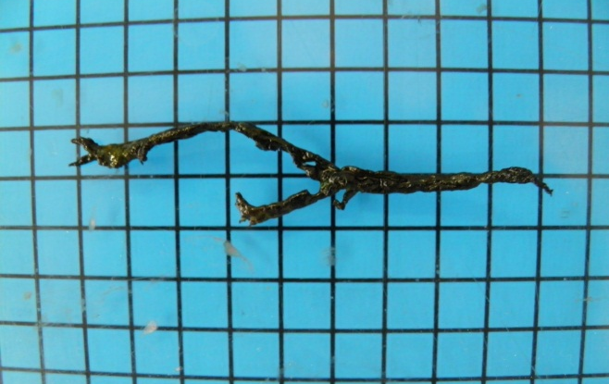
Foto fixiert
biliary cast

Slide 24
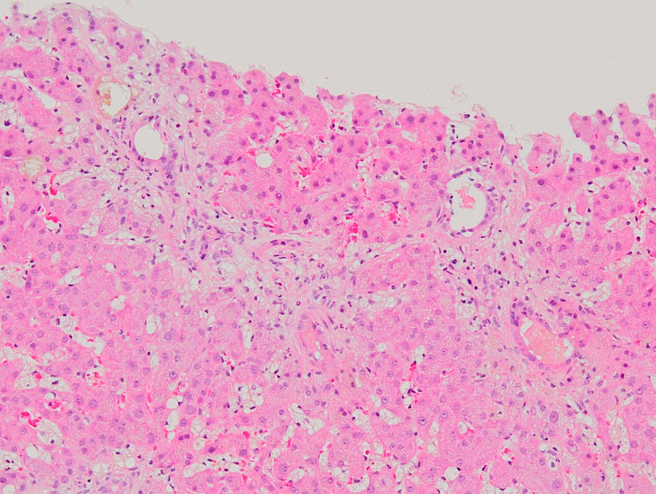
Slightly expanded portal tract with minimal inflammation
Degenerative changes of bile duct epithelium

Slide 25
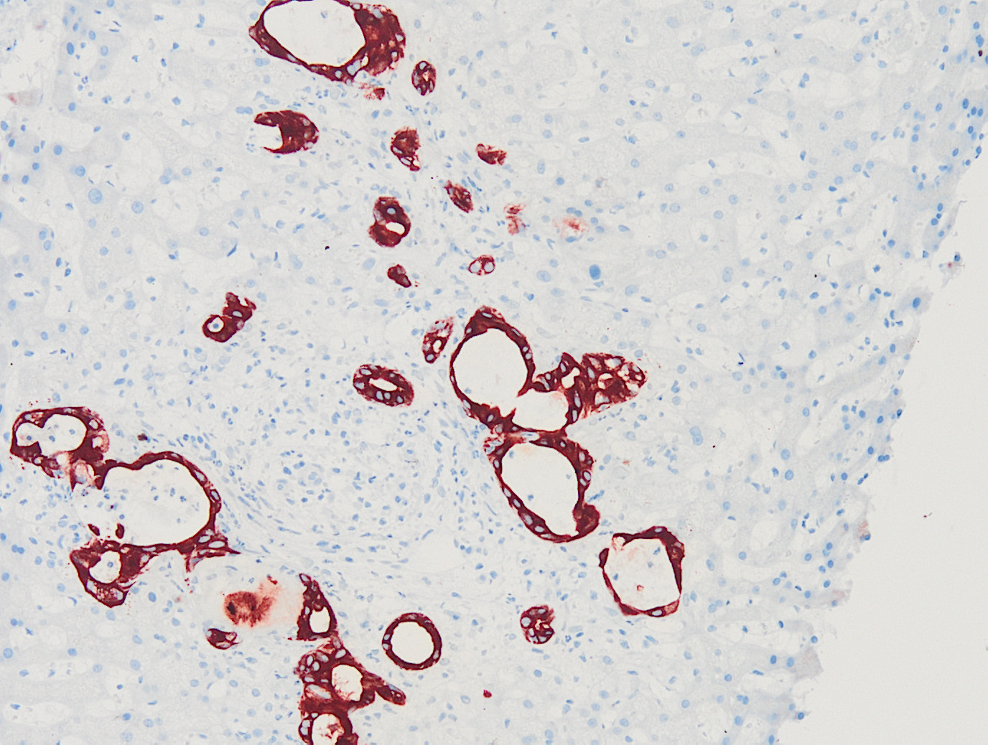
CK7
Ductular reaction

Slide 26
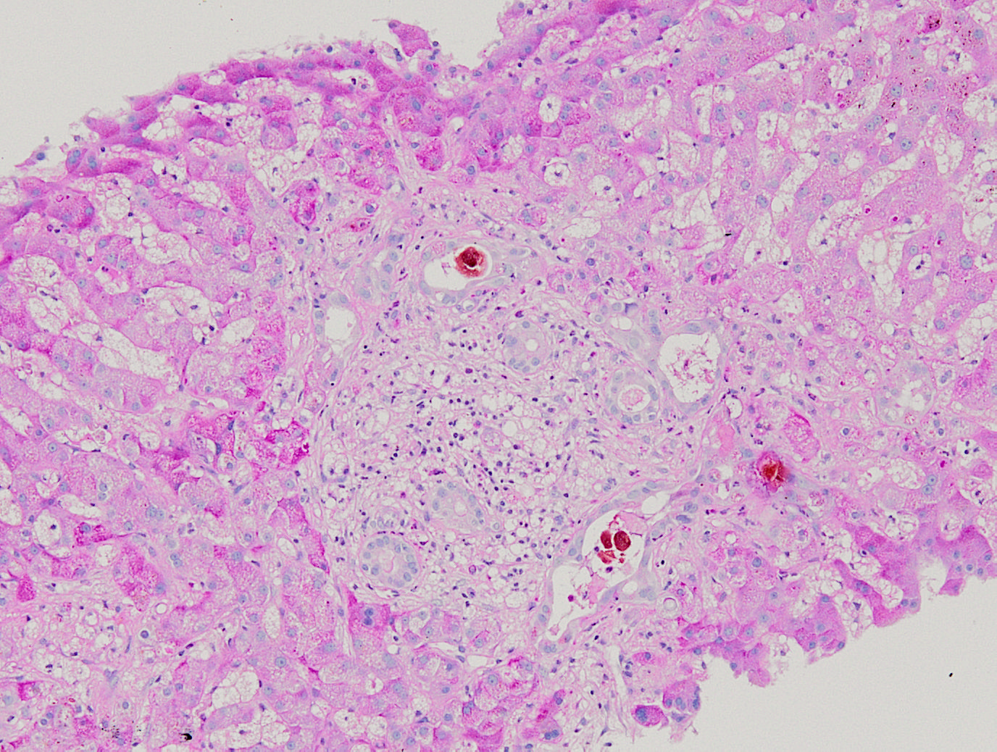
Ductular cholestasis

Slide 27
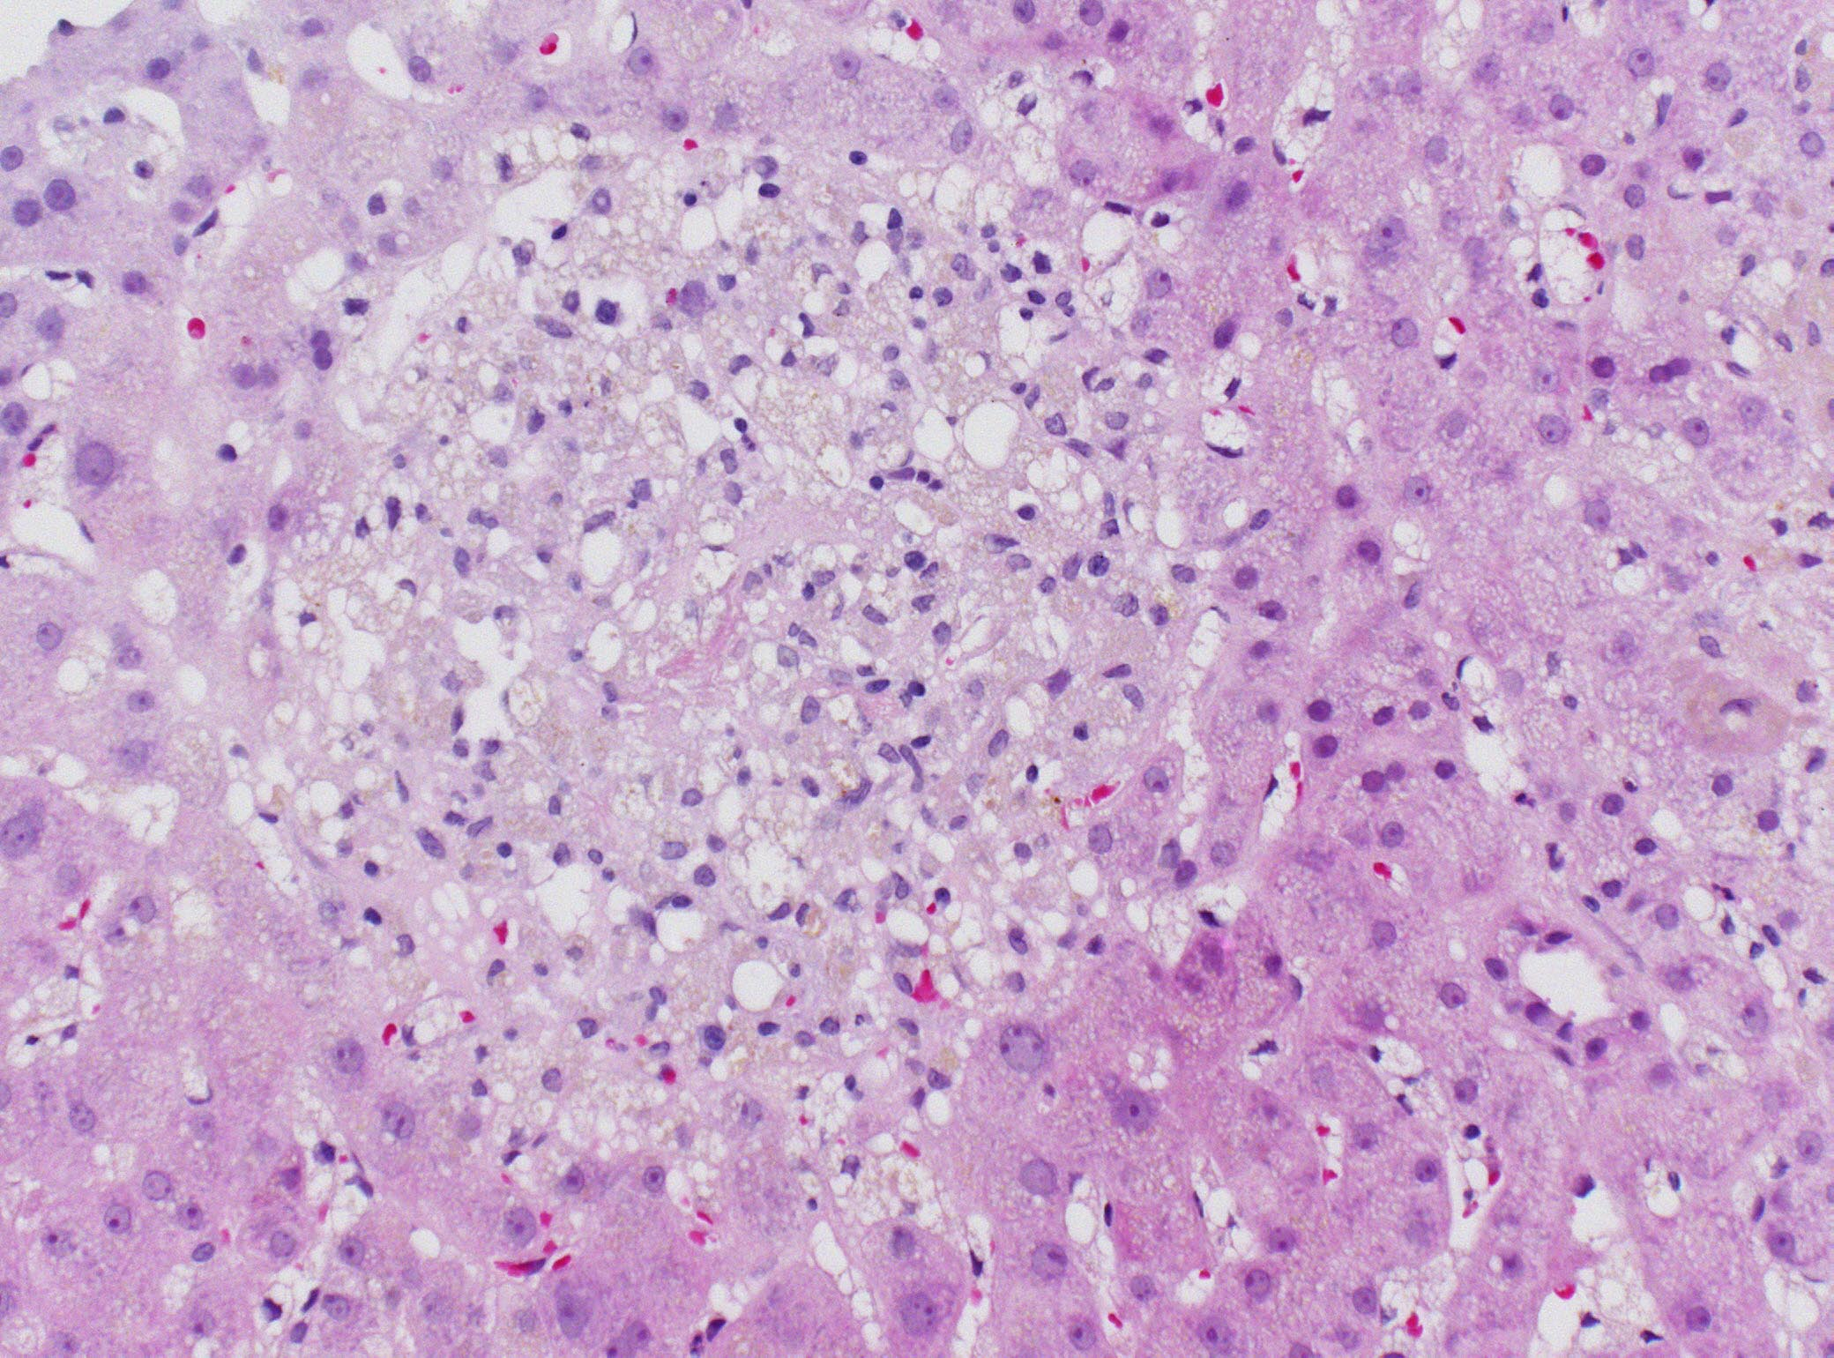
Periportal bile infarct

Slide 28
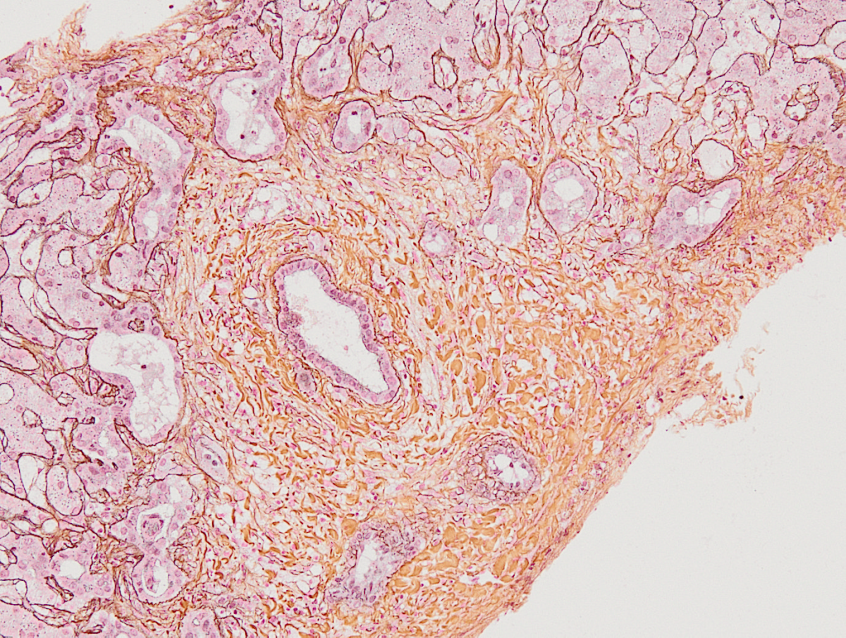
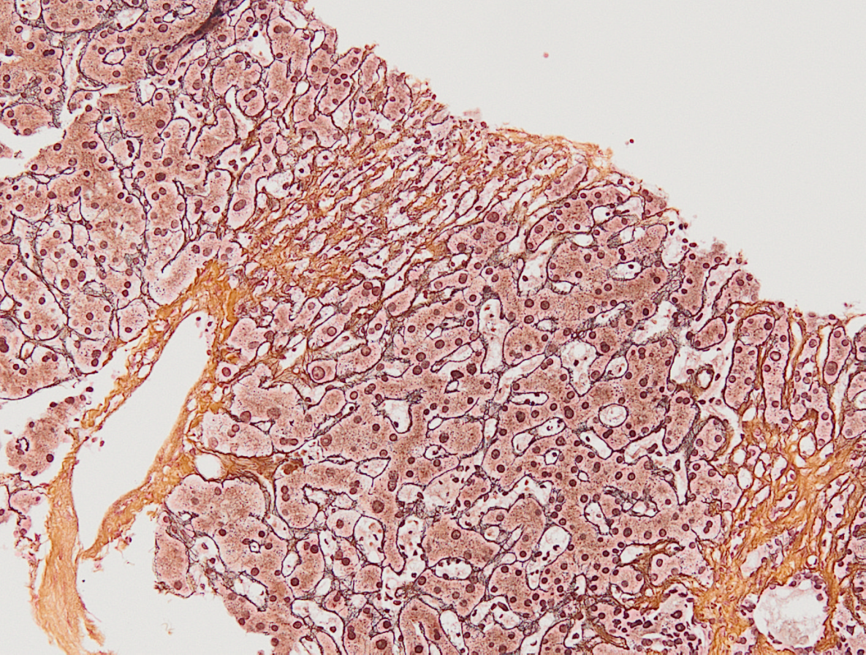
Gomori
Perivenular „drop-out“
of hepatocytes

Slide 29
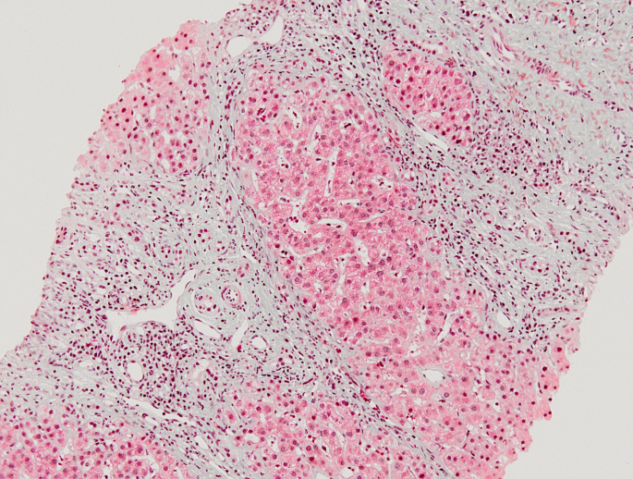
Liver cirrhosis
Masson

Slide 30
Gudnason, Clin Exp Gastroenterol 2017

Slide 31
Diagnosis of ICU-SSC
Clinical history
Post trauma, burning, major surgery (e.g. heart surgery)
no previous hepatobiliary disease
Clinical picture:
ICU-stay, Sepsis
-Laboratory: cholestasis parameters ↑; secondary AST/ALT ↑
Echo: normal vessels
ERCP/MRCP: Biliary casts – multifocal strictures with prestenotic dilatation

Slide 32
ICU-SSC: Progression model
primary insult portal changes secondary acinar changes
bile duct
10 Pt; 16-68 J; Biopsy 1,5-6,5 Mo. after initial event
hepatic artery
portal venule
central vein
hepatocyte
inflammatory cell
Esposito et al, Virchows Arch 2008

Slide 33
ICU-SSC: Pathogenesis
Ischaemia
- selective hypoperfusion of the liver
(hypotension, adrenalin/noradrenalin, mechanical ventilation, prone position, microthrombosis due to endothelial damage)
2. „Toxic bile“
- missing protection against bile acids
- possible genetic predisposition (defects of the MDR3 transporter)
Gudnason, Clin Exp Gastroenterol 2017

Slide 34
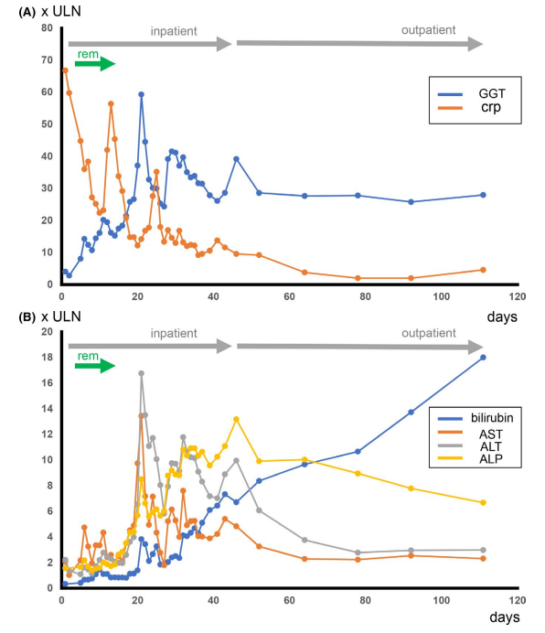
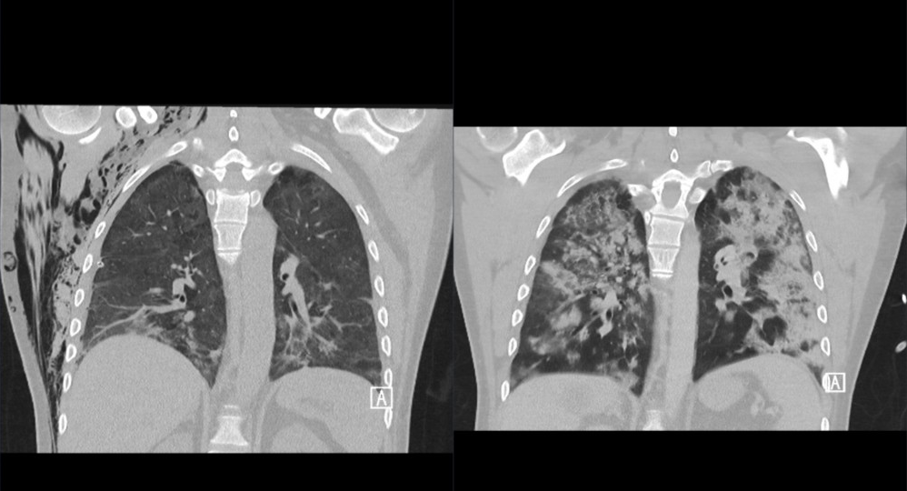
47 J M, BMI 24
Covid-19: ARDS, invasive ventilation for about 25 days
Klindt et al, Clin Case Rep 2021

Slide 35
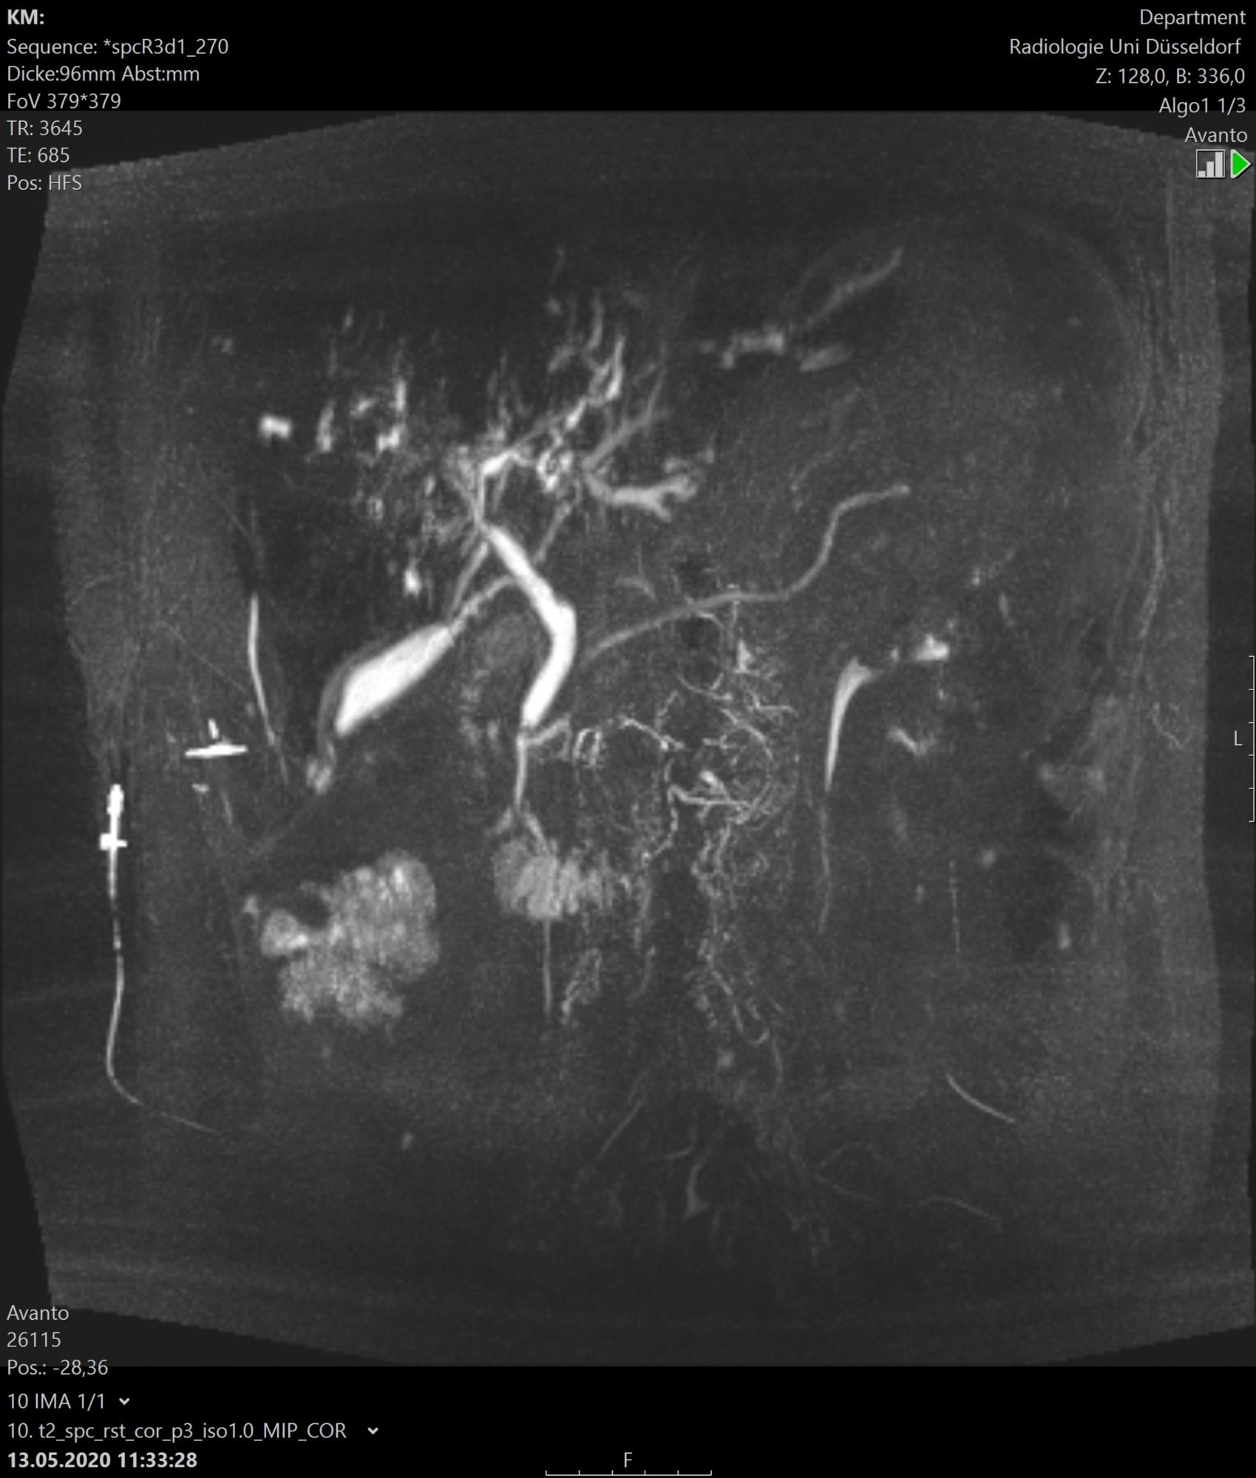
MRCP 79 days after initial presentation
Liver-Bx at day 50
Klindt et al, Clin Case Rep 2021

Slide 37
Differential diagnoses of ICU-SSC
Sepsis
DILI
Ischaemic hepatitis
Bile duct obstruction
TPN-associated cholestasis

Slide 38
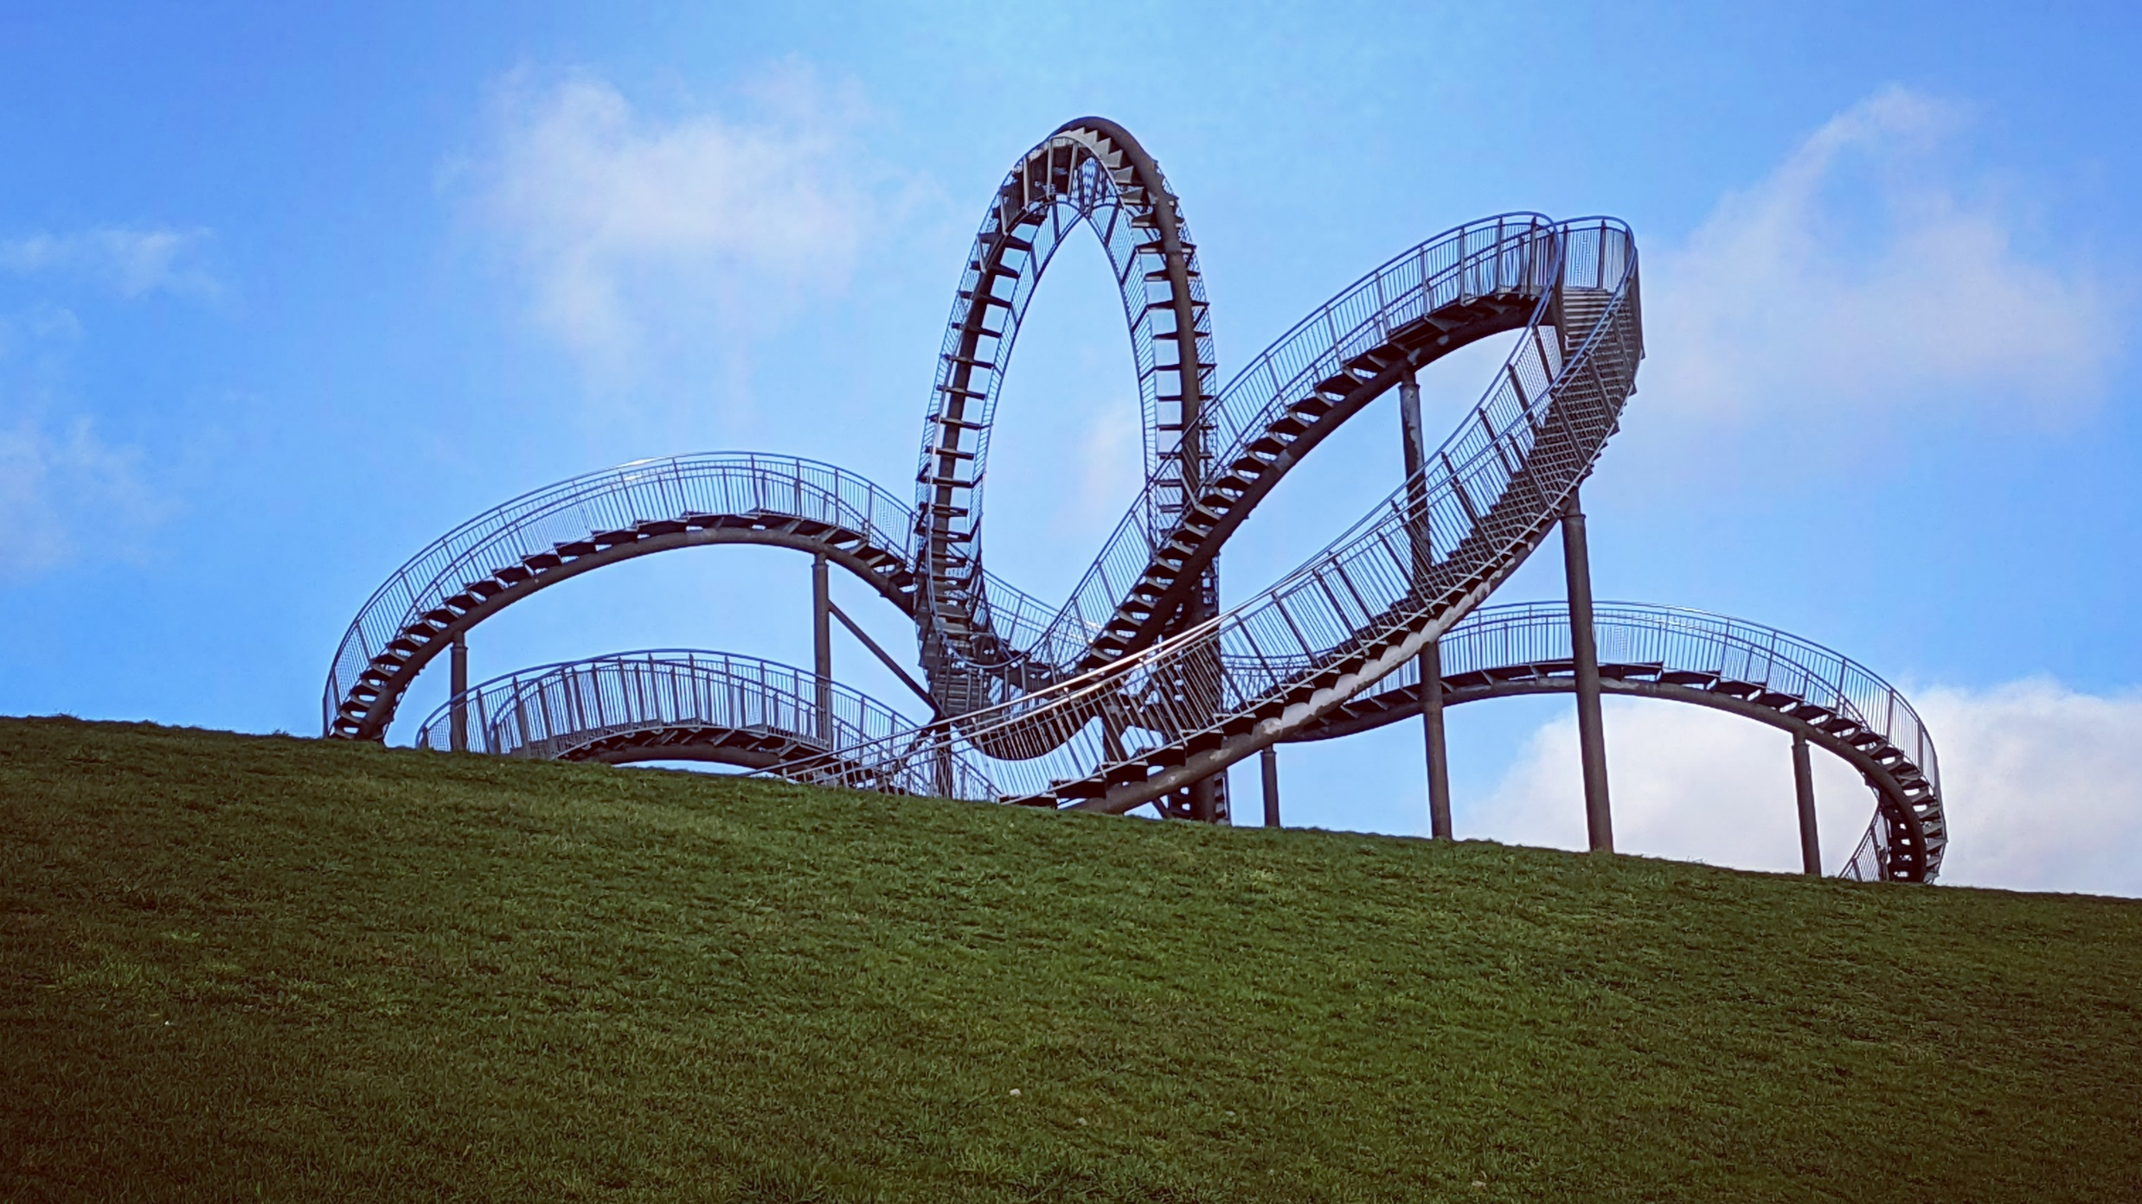
„Tiger & Turtle“ - Duisburg

